Slide 1
Lynbrook Education Foundation
Library Media Program Grant
Spring 2019

Slide 2
Statement of Need
Library Media Centers interested in fostering:
Alternate means of sharing knowledge
Provide creative outlet for students
Enhance student coding with hands-on learning opportunties

Slide 3
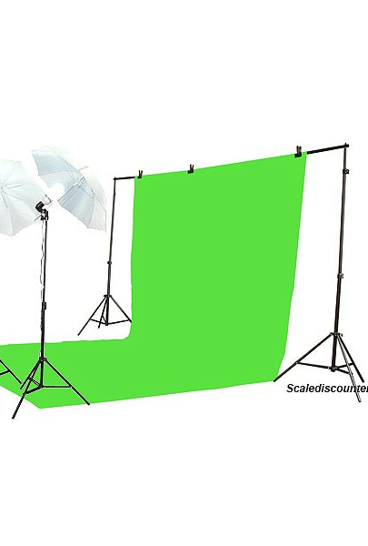
Portable Green Screen Studio
Mobile solution to turn every classroom into a mini production studio.
Greenscreen
Stands
Lights

Slide 4
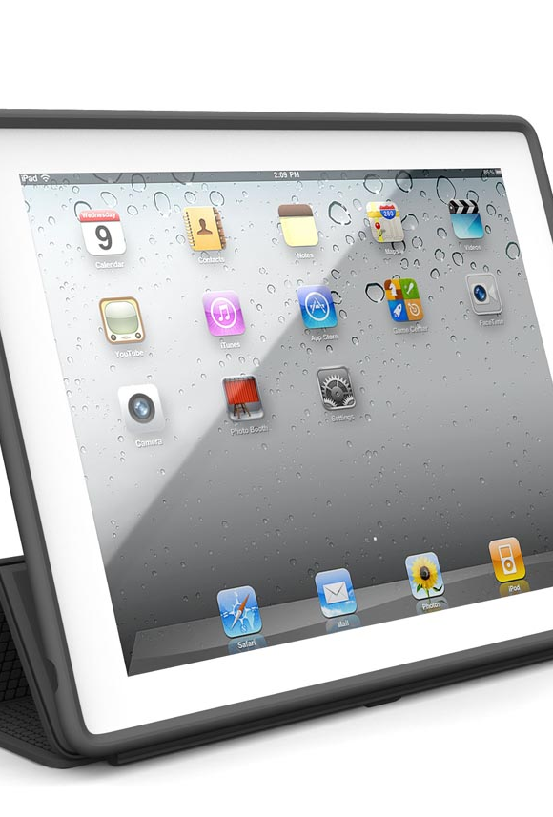
Apple iPads
Extremely user friendly device for developing digital content
Intuitive and powerful greenscreen software available
This Photo by Unknown Author is licensed under CC BY-SA-NC

Slide 5
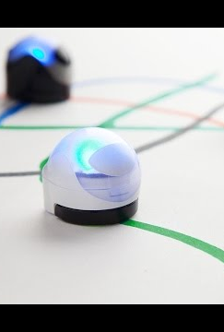
Ozobots
Robots to promote student understanding of fundamental of coding.
Hands on learning opportunities

Slide 6
Sincere thanks to the Lynbrook Excellence in Education Foundation

